Slide 1
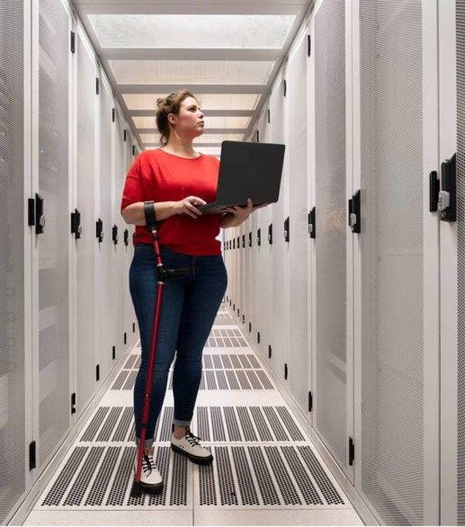
Image filtering and edge detection.
A05
Presentation by: Group 1

Slide 2
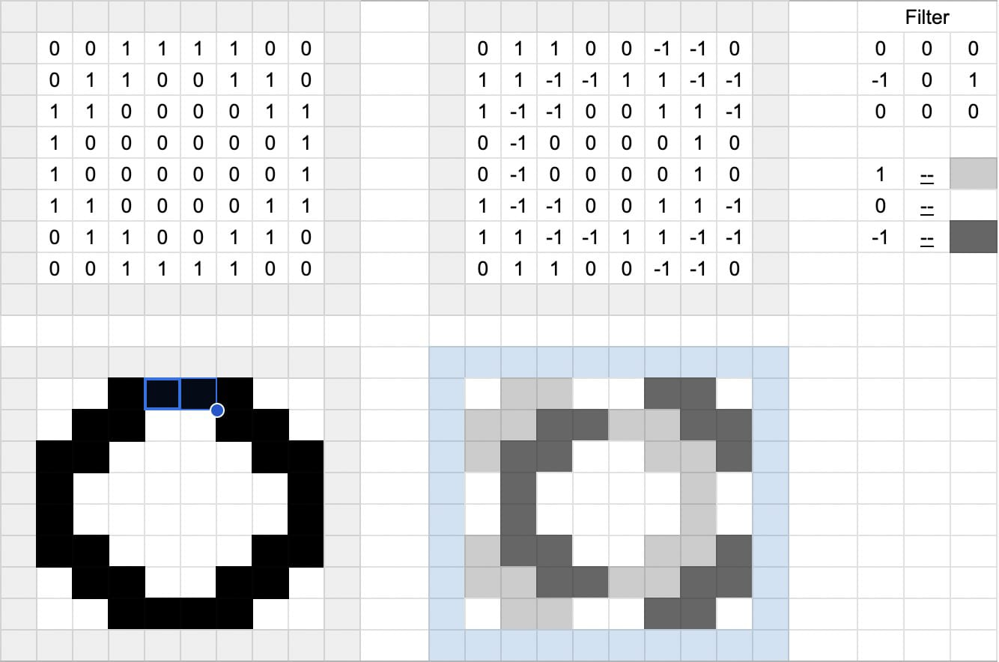

Slide 3
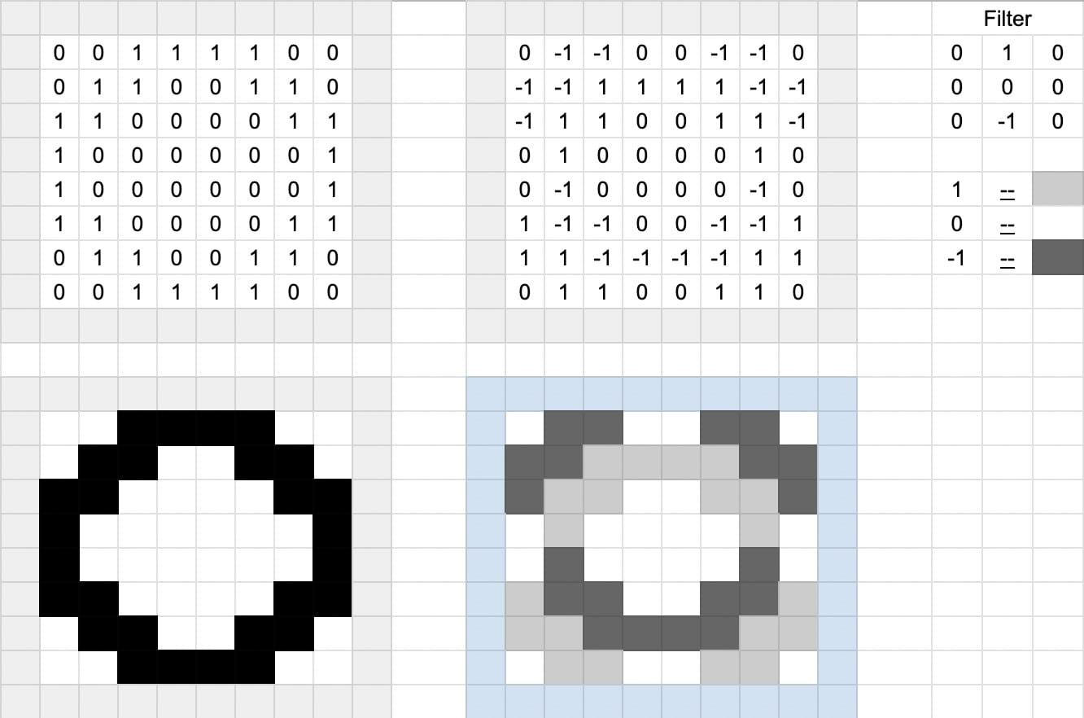

Slide 4
Techniques: How the magic happens
Convolution: Applying a filter kernel (matrix) to each pixel, multiplying corresponding values with adjacent pixels, and summing them to get the new pixel value. Popular filters include Gaussian blur, median filter, Sobel filter for edge detection.
Frequency domain filtering: Transforming the image to the frequency domain (using Fourier transform), manipulating specific frequency bands, and transforming back to the spatial domain. (different dimensions vertically and ho)
Non-linear filtering: Techniques like bilateral filtering or guided filtering utilize additional information (e.g., edge maps) to adaptively modify pixel values while preserving edges.

Slide 5
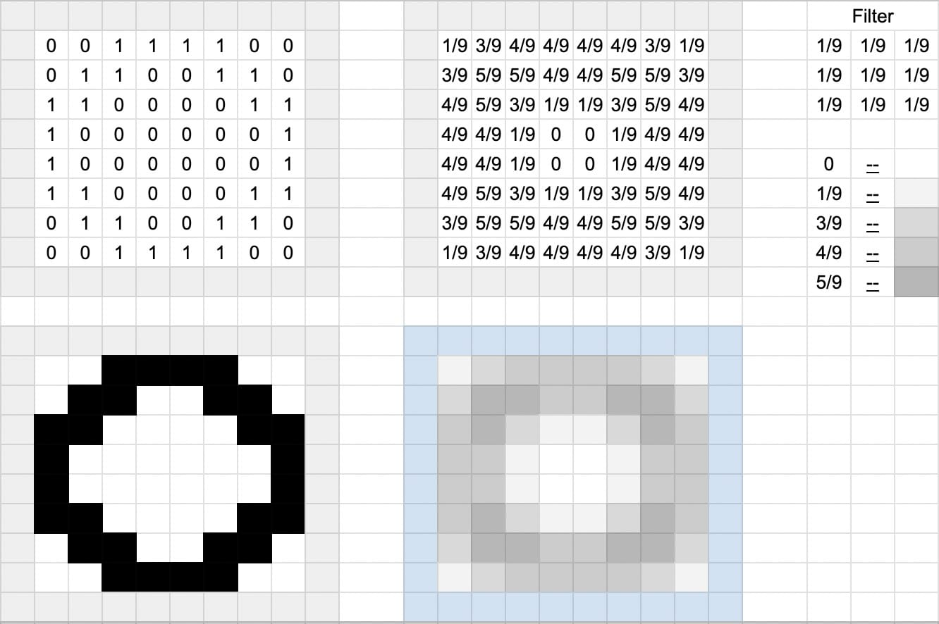

Slide 6

Lesson Learned
What does these mean to us?
How is it being used, providing real examples and anticipating the future.

Slide 7
Image processing and edge detection have a vast range of applications in various fields, impacting our daily lives in numerous ways. Here are some real-world examples:
Medical Imaging:
Detecting tumors and abnormalities: Edge detection is used in X-rays, mammograms, and MRIs to identify abnormalities in tissue density, helping diagnose diseases like cancer at early stages.
Surgical guidance: Real-time edge detection during surgery helps surgeons visualize anatomical structures and tumors more accurately, leading to minimally invasive procedures with improved outcomes.
Automated analysis: Algorithms trained on edge-detected images automate tasks like cell counting or blood vessel analysis, aiding in faster diagnosis and treatment decisions.
Robotics and Automation:
Object recognition and tracking: Robots use edge detection to identify objects in their environment, enabling tasks like autonomous navigation, object manipulation, and quality control.
Self-driving cars: Lane detection and obstacle identification rely heavily on edge detection algorithms, ensuring safe and reliable autonomous driving.
Facial recognition: Edge detection plays a crucial role in identifying facial features like eyes, nose, and mouth, enabling applications like security systems and personalized marketing.

Slide 8
Manufacturing and Quality Control:
Defect detection: Automated inspection systems use edge detection to identify flaws in products on assembly lines, ensuring quality control and minimizing defects.
Robot-assisted welding: Precise edge detection guides robots in welding tasks, improving accuracy and efficiency in manufacturing processes.
Automated packaging: Systems employing edge detection ensure proper product placement and alignment for efficient packaging and safe transportation.
Security and Surveillance:
Motion detection: Security cameras use edge detection to identify moving objects, triggering alerts and improving security measures.
Facial recognition for access control: Secure building access can be granted or denied based on facial recognition systems aided by edge detection.
Traffic monitoring: Automated traffic management systems use edge detection to identify vehicles and track their movement, optimizing traffic flow and reducing congestion.
Other Applications:
Satellite imaging: Edge detection helps identify geographical features, analyze land cover changes, and monitor environmental conditions.
Fingerprint and iris recognition: Secure authentication systems rely on edge detection to extract unique features from fingerprints or irises for identification.
Augmented reality: Edge detection enables accurate overlaying of digital information onto real-world images, creating immersive AR experiences.

Slide 9

Thank you
Questions and suggestions

